Slide 1
Lab 9
by wwy

Slide 2
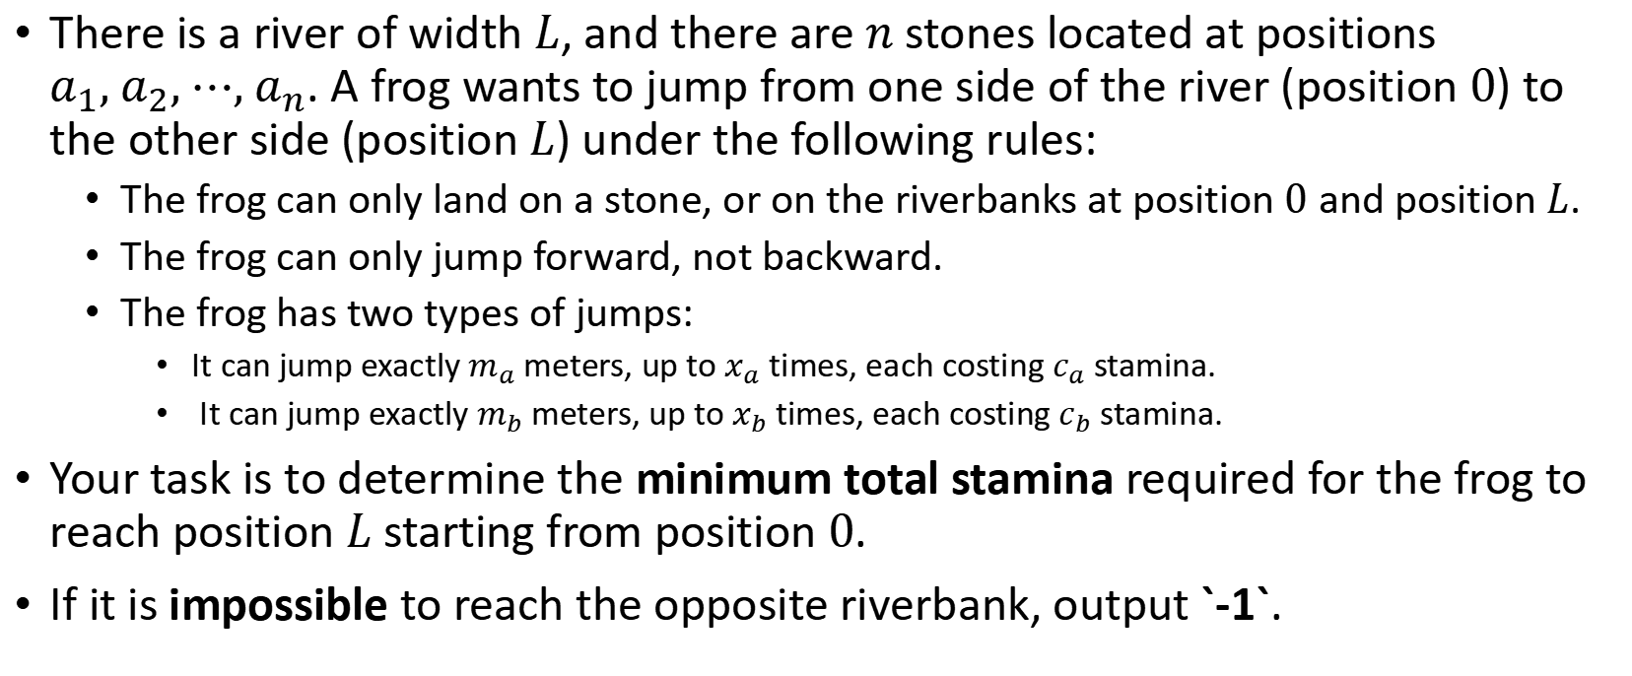
Lab9A
There is a river of width $L$, and there are $n$ stones located at positions $a_{1}, a_{2}, ⋯, a_{n}$. A frog wants to jump from one side of the river (position $0$) to the other side (position $L$) under the following rules:
The frog can only land on a stone, or on the riverbanks at position $0$ and position $L$.
The frog can only jump forward, not backward.
The frog has two types of jumps:
It can jump exactly $m_{a}$ meters, up to $x_{a}$ times, each costing $c_{a}$ stamina.
It can jump exactly $m_{b}$ meters, up to $x_{b}$ times, each costing $c_{b}$ stamina.
Your task is to determine the minimum total stamina required for the frog to reach position $L$ starting from position $0$.
If it is impossible to reach the opposite riverbank, output `-1`.

Slide 3
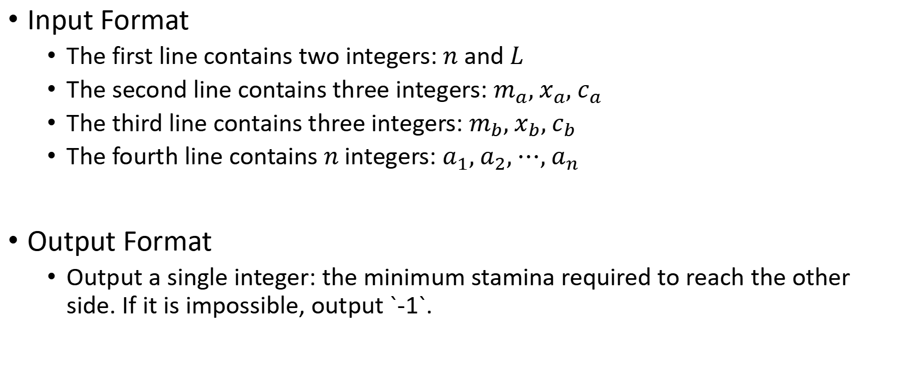
Lab9A
Input Format
The first line contains two integers: $n$ and $L$
The second line contains three integers: $m_{a}, x_{a}, c_{a}$
The third line contains three integers: $m_{b}, x_{b}, c_{b}$
The fourth line contains $n$ integers: $a_{1}, a_{2}, ⋯, a_{n}$
Output Format
Output a single integer: the minimum stamina required to reach the other side. If it is impossible, output `-1`.

Slide 4
Lab9A
10 20
2 9 9
3 6 5
3 4 5 7 9 11 13 15 17 19
73
5 9 9 9 9 9 9 9 5
0
3
4
5
7
9
11
13
15
17
19
20

Slide 5
Lab9A
15 50
5 20 9
7 15 5
3 4 5 7 12 17 18 19 21 26 31 37 38 41 45
43
5 9 5 5 9 5 5
0
3
4
5
7
12
17
18
19
21
26
31
37
38
41
45

Slide 6
Lab9B
At the end of the semester, a student at SUSTech wants to thank a TA who has provided significant help throughout the term. To show appreciation, the student decides to buy the TA’s favorite treat — milk candy. However, after recently buying gifts for friends during his holiday, the student only has n yuan left. Fortunately, the nearby campus store offers m types of milk candy, each sold as a whole package and not individually.
The student wants to buy some candy without exceeding the budget and aims to maximize the total sugar content obtained. Please help calculate the maximum sugar he can get, along with the specific number of packages to buy for each candy type.
Given an integer n (the total amount of money available) and m (the number of candy types), along with the price and sugar content of each type of candy, determine:
The maximum total sugar the student can obtain within the budget;
A valid purchase plan, showing how many units of each candy to buy.
Each candy type has an unlimited supply, and each unit has a positive integer price.
It is guaranteed that there exists exactly one optimal solution.

Slide 7
Lab9B
Input Format
The first line contains two integers, n and m — the amount of money available and the number of candy types.
The next m lines each contain two integers a and b, where a is the price and b is the sugar content of that type.
Output Format
The first line outputs a single integer: the maximum total sugar that can be obtained.
The following m lines: the j-th line (1-based) should output the number of units bought of the j-th type of candy.

Slide 8
Lab9B
70 3
71 100
69 1
1 2
140
0
0
70

Slide 9
THX:-)

